Slide 1

Usage Funnels with Warby Parker
Learn SQL from Scratch
Shana Shephard
Dec 4th, 2018

Slide 2
Table of Contents
Warby Parker’s Survey
1.1 Survey Detail
1.2 Survey Responses
1.3 Quiz Completion Rates
Home Try On Funnel
2.1 Home Try On Funnel
2.2 Home Try On Funnel Join
2.3 Insights

Slide 3
1. Warby Parker’s Survey

Slide 4
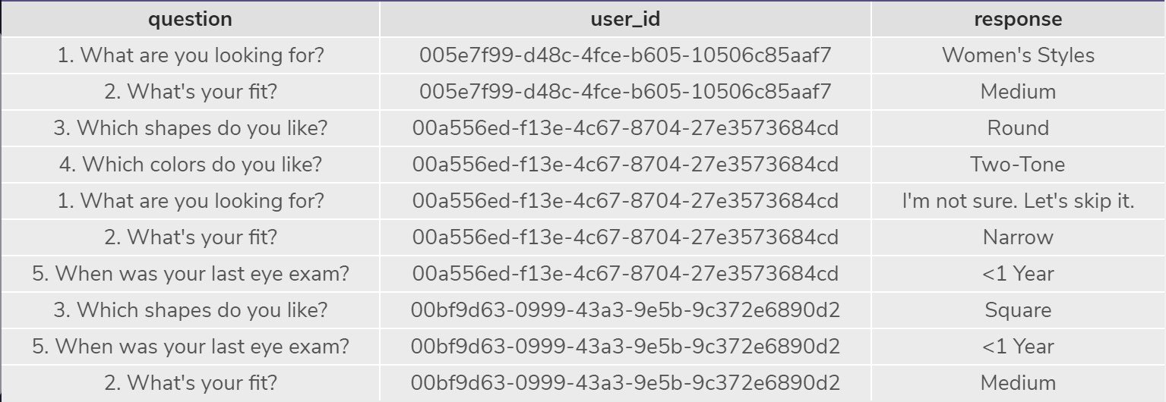
1.1 Survey Details
Survey Table: Select all columns from the first 10 rows. What columns does the table have?
The survey table has 3 columns: question, user_id and response
SELECT *
FROM survey
LIMIT 10;

Slide 5
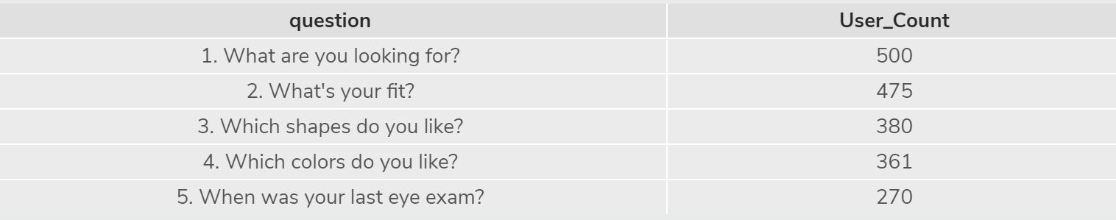
1.2 Survey Responses
Survey Table: What is the number of responses for each question?
Question 1 has 500
Question 2 has 475
Question 3 has 380
Question 4 has 361
Question 5 has 270
SELECT question,
COUNT (DISTINCT user_id) AS User_Count
FROM survey
GROUP BY 1
ORDER BY 1;

Slide 6
1.3 Quiz Completion Rates
Which question(s) of the quiz have a lower completion rates? What do you think is the reason?
Question 5 (When was your last eye exam?) has the lowest completion rate. Users may not remember the date of their last eye exam and may not be willing to take the additional time to find this information as it does not impact their choice in eyewear. Other users may be using the quiz to browse Warby Parker’s available assortment before determining if they will use the service and prefer to skip to get to the results faster.

Slide 7
2. Home Try On Funnel

Slide 8
2.1 Home Try-On Funnel
Examine the first five rows of each table (quiz, home_try_on and purchase). What are the column names?
The column names for each table are listed below and shown on the following slide:
Quiz: user_id, style, fit, shape and color
Home_try_on: user_id, number_of_pairs, address
Purchase: user_id, product_id, style, model_name, color and price
SELECT *
FROM quiz
LIMIT 5;
SELECT *
FROM home_try_on
LIMIT 5;
SELECT *
FROM purchase
LIMIT 5;

Slide 9
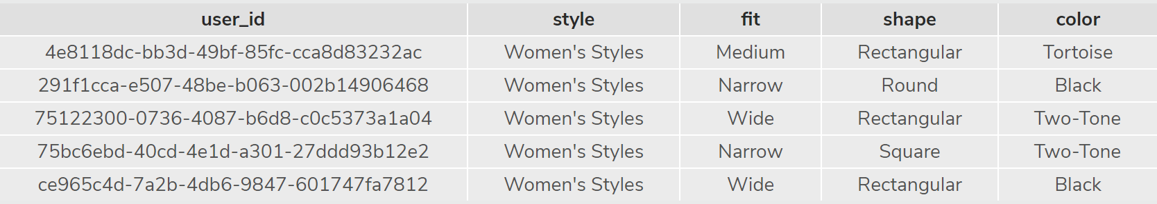
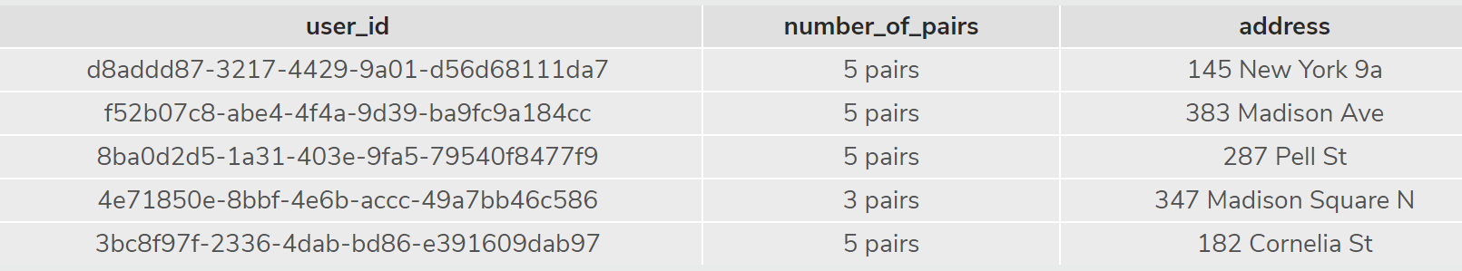
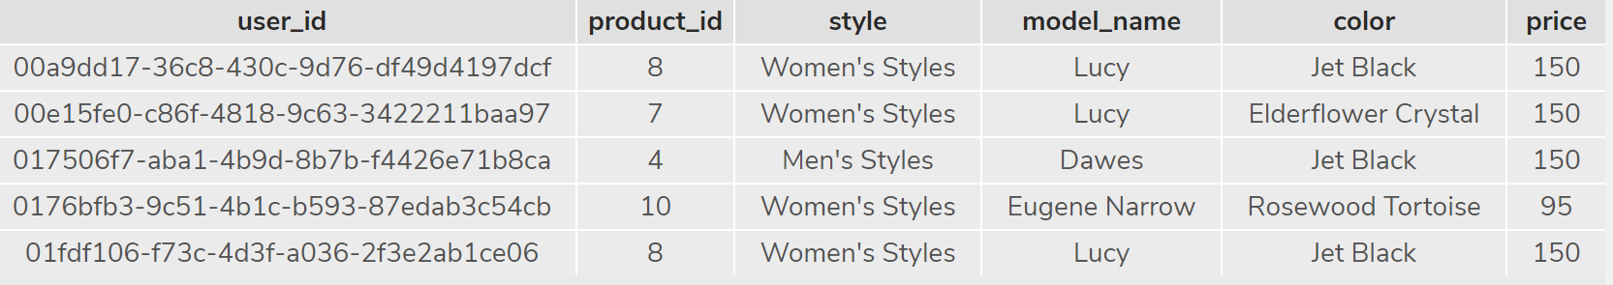
quiz
home_try_on
purchase

Slide 10
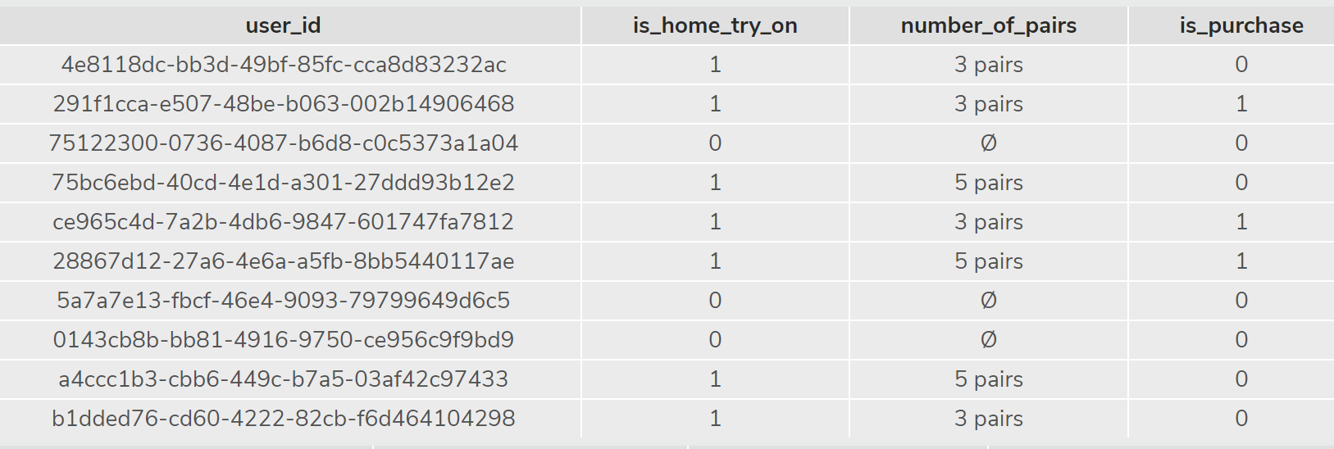
2.2 Home Try-On Funnel Join
SELECT DISTINCT q.user_id,
h.user_id IS NOT NULL AS 'is_home_try_on',
h.number_of_pairs,
p.user_id IS NOT NULL AS 'is_purchase'
FROM quiz AS 'q'
LEFT JOIN home_try_on AS 'h'
ON h.user_id = q.user_id
LEFT JOIN purchase AS 'p'
ON p.user_id = h.user_id
LIMIT 10;
Left Join of quiz, home_try_on and purchase tables.
Select only the first 10 rows from this table

Slide 11
2.3 Insights
What are some actionable insights for Warby Parker?
The quiz is a successful tool for helping users narrow down styles that would interest them. 75% of users that take the quiz go on to select styles to try at home.
Of the users that try styles on at home, those that are able to select 5 styles instead of 3 are more likely to purchase. 79% of users that selected 5 pairs made a purchase compared to 53% of users that were limited to 3 pairs. Increasing the number of frames increases the probability of a purchase.
WITH funnels AS (SELECT DISTINCT q.user_id,
h.user_id IS NOT NULL AS 'is_home_try_on',
h.number_of_pairs,
p.user_id IS NOT NULL AS 'is_purchase'
FROM quiz AS 'q'
LEFT JOIN home_try_on AS 'h'
ON h.user_id = q.user_id
LEFT JOIN purchase AS 'p'
ON p.user_id = h.user_id)
SELECT number_of_pairs, COUNT(*) AS 'num_quiz',
SUM(is_home_try_on) AS 'num_try',
SUM(is_purchase) AS 'num_purchase'
FROM funnels
GROUP BY 1
ORDER BY 1;

Slide 12
Insights Continued
Tortoise Shell is the most popular color selected in the quiz and the top Ladies style purchased is the Eugene Narrow in Rosewood Tortoise followed by the same style in Rose Crystal. The most popular men’s style is the Dawes in Driftwood Fade followed by the Brady in Layered Tortoise Matte. These results indicate that Warby Parker should ensure they have a wide offering of styles in Tortoise for both Men and Women.
It should also be noted that 53% of the purchases made were frames at the $95 price point, 39% at the $150 price point and the remaining 8% at $50. This may indicate that there is an opportunity for Warby Parker to raise the entry level price point and offer styles above $50 as their customer is willing to spend more for frames they like with the convenience of at home try on.
SELECT color, COUNT (DISTINCT user_id)
FROM QUIZ
GROUP BY 1;
SELECT product_id, model_name, style, color, COUNT(*)
FROM purchase
GROUP BY 1
ORDER BY 5 DESC;
SELECT price, count(*)
FROM purchase
GROUP BY 1;

